Slide 1
Nature Language Processing: Sentiment Analysis on Mental Health Problem Classification
CHAN, Chun Hin (20853893)
LAW, Hui Nok (20860535)
Youtube link: https://youtu.be/Z-gUddy29Cs

Slide 2
Introduction

Slide 3
Introduction
Source
Obtained from https://www.kaggle.com/datasets/reihanenamdari/mental-health-corpus
Mental Health Corpus

Slide 4
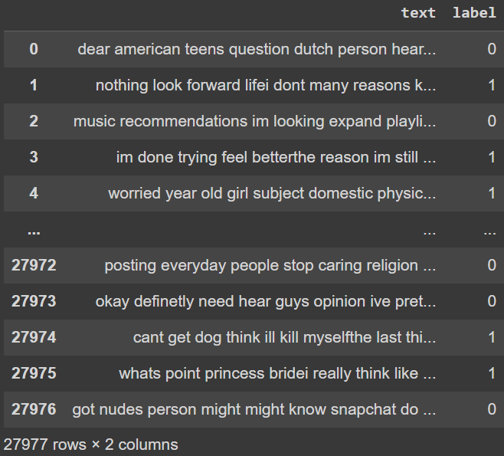
Introduction
Structure of the Dataset
Number of Data Samples: 27977
Number of Columns: 2
First Column:
Column Name: text
Data Type: string
People’s comments
Second Column:
Column Name: label
Data Type: string
Binary: 0 or 1
Label 0: comment is not poisonous; commenter does not have potential mental health illnesses/issues
Label 1: comment is poisonous; commenter has potential mental health illnesses/issues

Slide 5
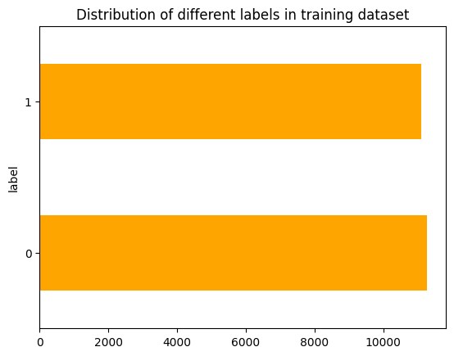
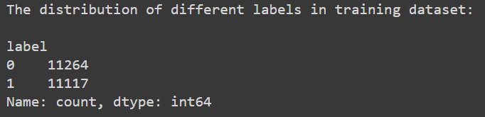
Introduction
Distribution of the Labels
Training Dataset:
Number of Label 0: 11264
Number of Label 1: 11117

Slide 6
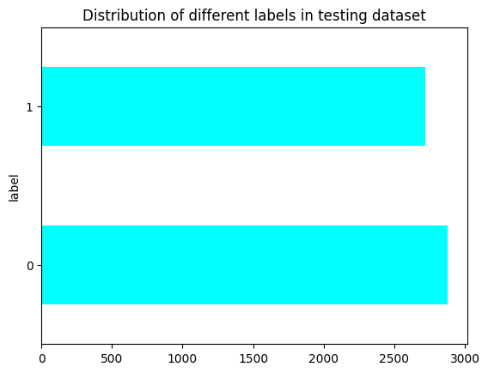
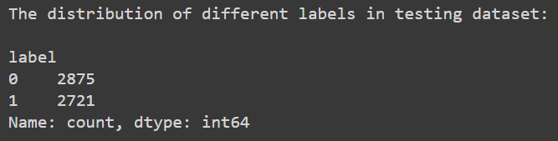
Introduction
Distribution of the Labels
Testing Dataset:
Number of Label 0: 2875
Number of Label 1: 2721

Slide 7
Introduction
Distribution of the Labels
Total:
Number of Label 0: 14139
Number of Label 1: 13838
Evenly Distributed

Slide 8

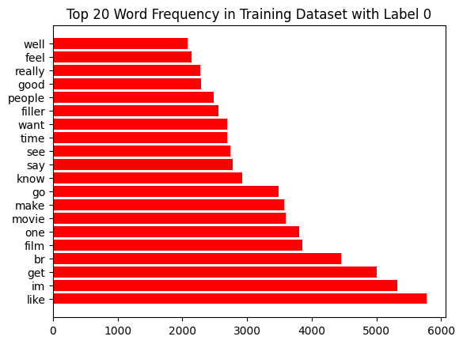
Introduction
Most Frequently Occurred Words in Each Label
Training Dataset (with Label 0)

Slide 9
Introduction
Most Frequently Occurred Words in Each Label
Training Dataset (with Label 0)
like | 5777 | one | 3800 | say | 2783 | people | 2487
im | 5326 | movie | 3592 | see | 2740 | good | 2286
get | 5004 | make | 3576 | time | 2697 | really | 2275
br | 4453 | go | 3485 | want | 2691 | feel | 2138
film | 3851 | know | 2921 | filter | 2553 | well | 2085

Slide 10
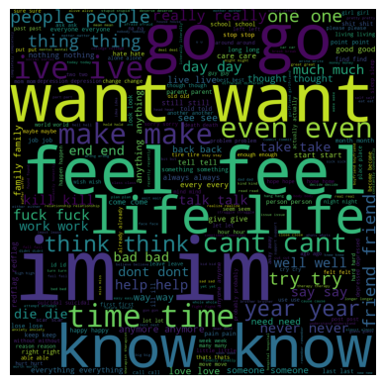
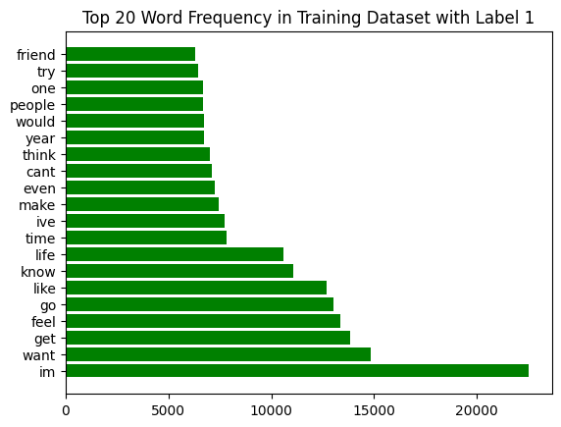
Introduction
Most Frequently Occurred Words in Each Label
Training Dataset (with Label 1)

Slide 11
Introduction
Most Frequently Occurred Words in Each Label
Training Dataset (with Label 1)
im | 22520 | like | 12712 | make | 7426 | would | 6726
want | 14818 | know | 11091 | even | 7249 | people | 6694
get | 13856 | life | 10611 | cant | 7095 | one | 6688
feel | 13362 | time | 7813 | think | 6999 | try | 6448
go | 13031 | ive | 7744 | year | 6740 | friend | 6286

Slide 12
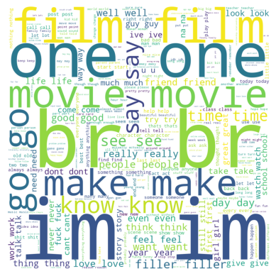
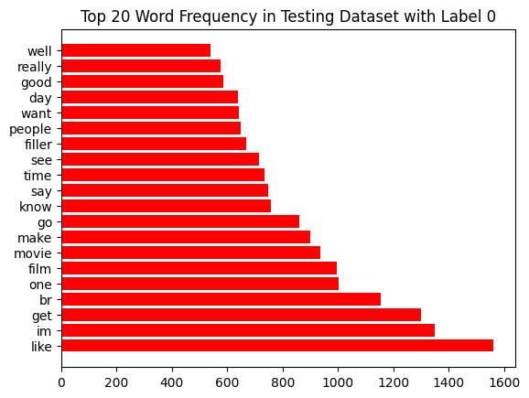
Introduction
Most Frequently Occurred Words in Each Label
Testing Dataset (with Label 0)

Slide 13
Introduction
Most Frequently Occurred Words in Each Label
Testing Dataset (with Label 0)
like | 1562 | film | 997 | say | 748 | want | 642
im | 1350 | movie | 935 | time | 733 | day | 639
get | 1299 | make | 899 | see | 714 | good | 585
br | 1155 | go | 859 | filler | 668 | really | 577
one | 1001 | know | 758 | people | 647 | well | 539

Slide 14

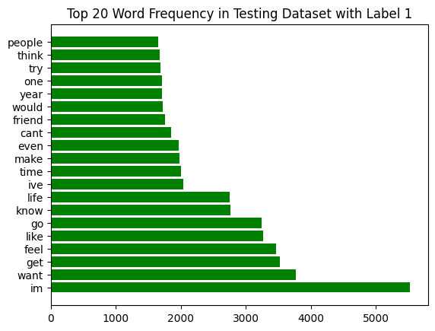
Introduction
Most Frequently Occurred Words in Each Label
Testing Dataset (with Label 1)

Slide 15
Introduction
Most Frequently Occurred Words in Each Label
Testing Dataset (with Label 1)
im | 5524 | go | 3244 | make | 1982 | year | 1714
want | 3762 | know | 2767 | even | 1965 | one | 1704
get | 3520 | life | 2747 | cant | 1846 | try | 1680
feel | 3464 | ive | 2035 | friend | 1752 | think | 1678
like | 3265 | time | 2006 | would | 1719 | people | 1656

Slide 16
Data Preprocessing

Slide 17
Data Preprocessing Technique
Lowercase
- Convert the words in String or List to lowercase
- Reducing the dimensionality when building corpus
- Stopwords removal is based on lowercase
Example:
Original Text: We are doing COMP 4211 Project!
After Processing: we are doing comp 4211 project!

Slide 18
Data Preprocessing Technique
2) Tokenization
- Separate all words, punctuations, and numbers into token
- Stemming, Removing Punctuations, and other preprocessing require a single token to process
Example:
Original Text in String: We are doing COMP 4211 Project!
After Processing in List of Token: [“We”, “are”, “doing”, “COMP”, “4211”, “Project”, “!”]

Slide 19
Data Preprocessing Technique
3) Removing Punctuations & Numbers
- Punctuations do not have much value in the analysis
- Number do not play a significant role in mental health classification
- Reducing the dimensionality of the token when building corpus
Example:
Original Text in a List of Token: [“We”, “are”, “doing”, “COMP”, “4211”, “Project”, “!”]
After Processing: [“We”, “are”, “doing”, “COMP”, “Project”]

Slide 20
Data Preprocessing Technique
4) Stemming or Lemmatization
Stemming
- Porter Stemming Algorithm
- Removing the prefix and suffix (in simple understanding, since this is not the main focus)
- Some meaningless word will appear such as “This” will become “Thi”
Lemmatization (We use this approach)
- Based on the part of speech of each word in the sentence, convert them back to the original form.
Example:
Original Text: [“We”, “are”, “doing”, “COMP”, “4211”, “Project”, “!”]
After Processing: [“We”, “be”, “do”, “COMP”, “4211”, “Project”, “!”]

Slide 21
Data Preprocessing Technique
5) Filter Stopwords
- Removing the stopwords (e.g. “is”, “the”) in the sentences since they do not carry meaningful information.
Example:
Original Text: [“We”, “are”, “doing”, “COMP”, “4211”, “Project”, “!”]
After Processing: [“We”, “doing”, “COMP”, “Project”]

Slide 22
Data Preprocessing Technique
6) N-Gram
- Capture the context and semantic information by considering a sequence of ‘n’ words together
Example:
Original Text: [“We”, “are”, “doing”, “COMP”, “4211”, “Project”, “!”]
N = 1: [“We”, “are”, “doing”, “COMP”, “4211”, “Project”, “!”]
N = 2: [“We are”, “are doing”, “ doing COMP”, “COMP 4211”, “4211 Project”, “Project !”]

Slide 23
Data Preprocessing Technique
7) Building Corpus
- Build the words corpus for the one-hot and index encoding
- <pad> = 0 is for the encoding with same length
- <unk> = 1 if for the words not find in the corpus
Example:

Slide 24
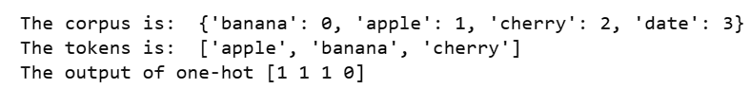
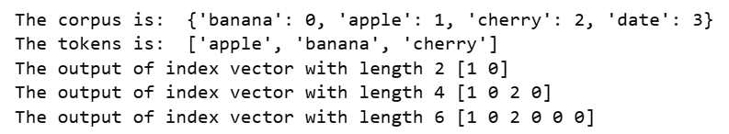
Data Preprocessing Technique
8) One-Hot Encoding
- Build the vector based on the corpus length
- If the words in the sentence are in the corpus, then that position will mark as 1.
9) Index Encoding
- The first n words we consider in the sentence and for the vector with its corpus index

Slide 25
Machine Learning Method

Slide 26
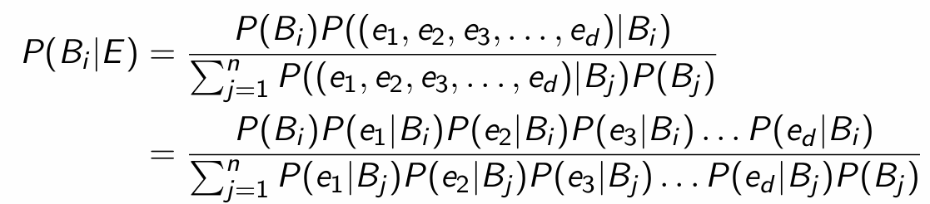
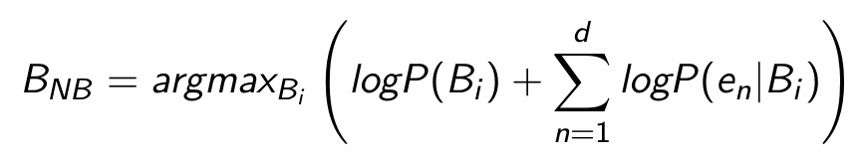
Machine Learning Method
1) Naive Bayes Classifier
- “Naive” assumes each piece of evidence is independent and equally contributes to the classes
- Just needs the numerator since the denominator is the same for each Believe
- We take the log to prevent the floating point underflow
- Take the argmax to get which class belong to

Slide 27
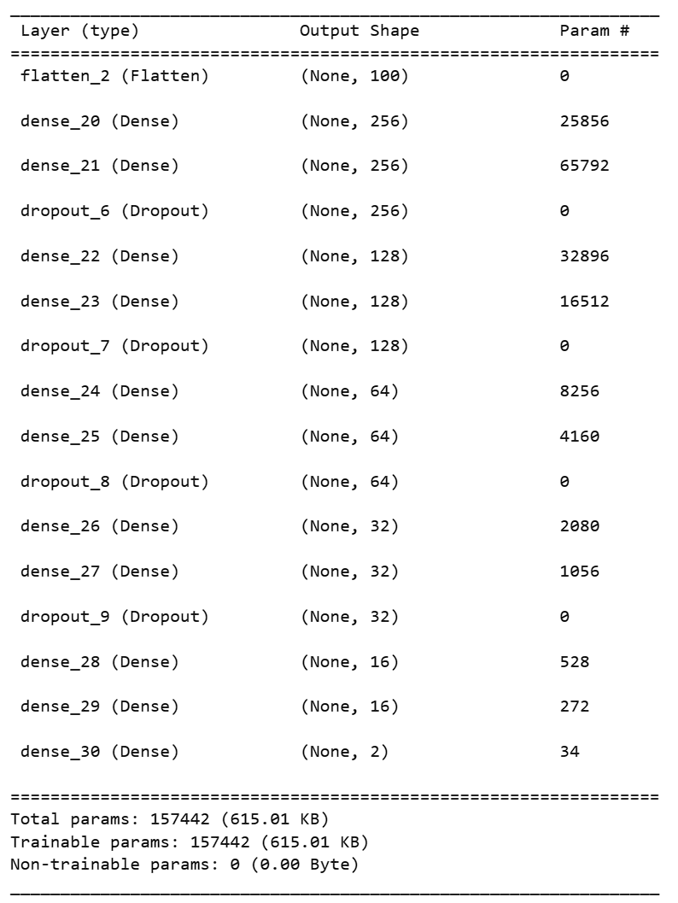
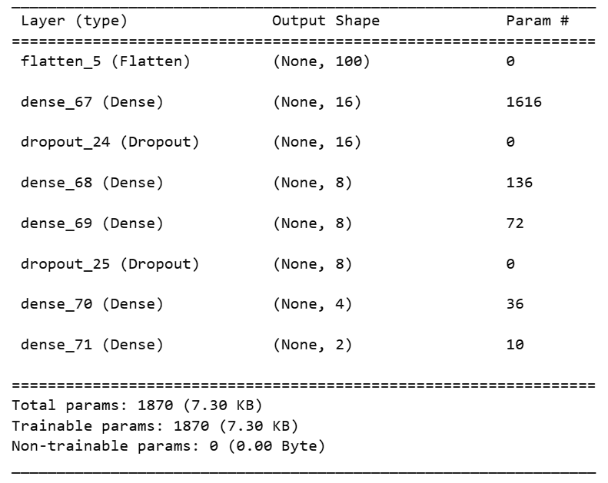
Machine Learning Method
2) One-Hot Model by MLP
- We have vector length = 100 and 1000 for the experiment
- Using the One-Hot preprocessing function to encode the sentence
- We have two models (one is simpler and one is more complex)
- Optimizer is using “adam”, Loss is using “binary_crossentropy”

Slide 28
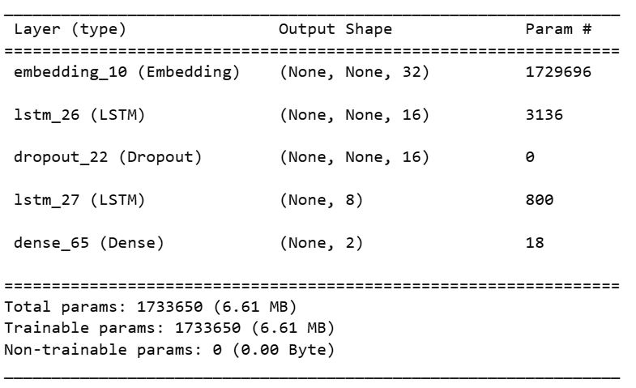
Machine Learning Method
3) Index Model by RNN
- We build the corpus for all words
- Get the Index Vector by the function with first 100 words in the sentence
- Optimizer is using “adam”, Loss is using “binary_crossentropy”

Slide 29
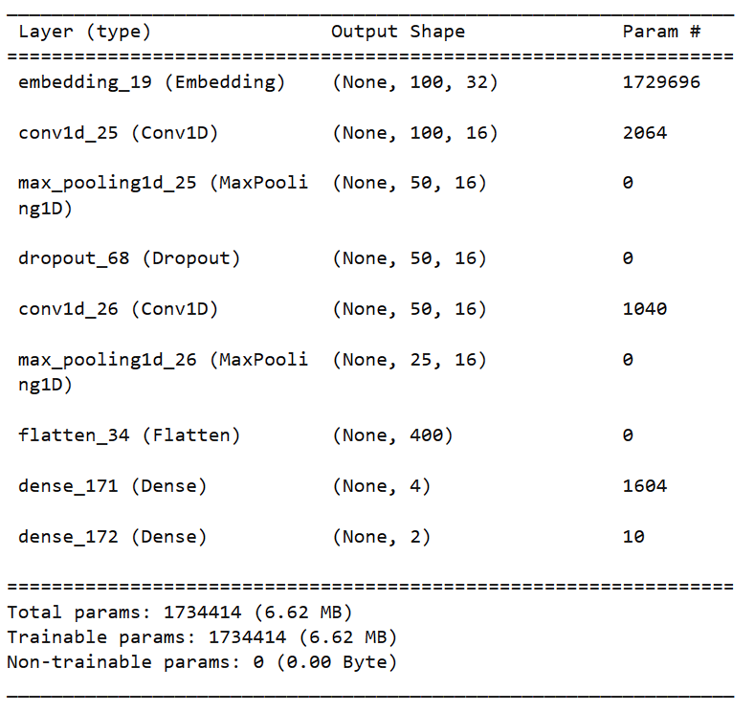
Machine Learning Method
4) CNN Model
- We build the corpus for all words
- Get the Index Vector by the function with first 100 words
in the sentence
- Optimizer is using “adam”, Loss is using “binary_crossentropy”

Slide 30
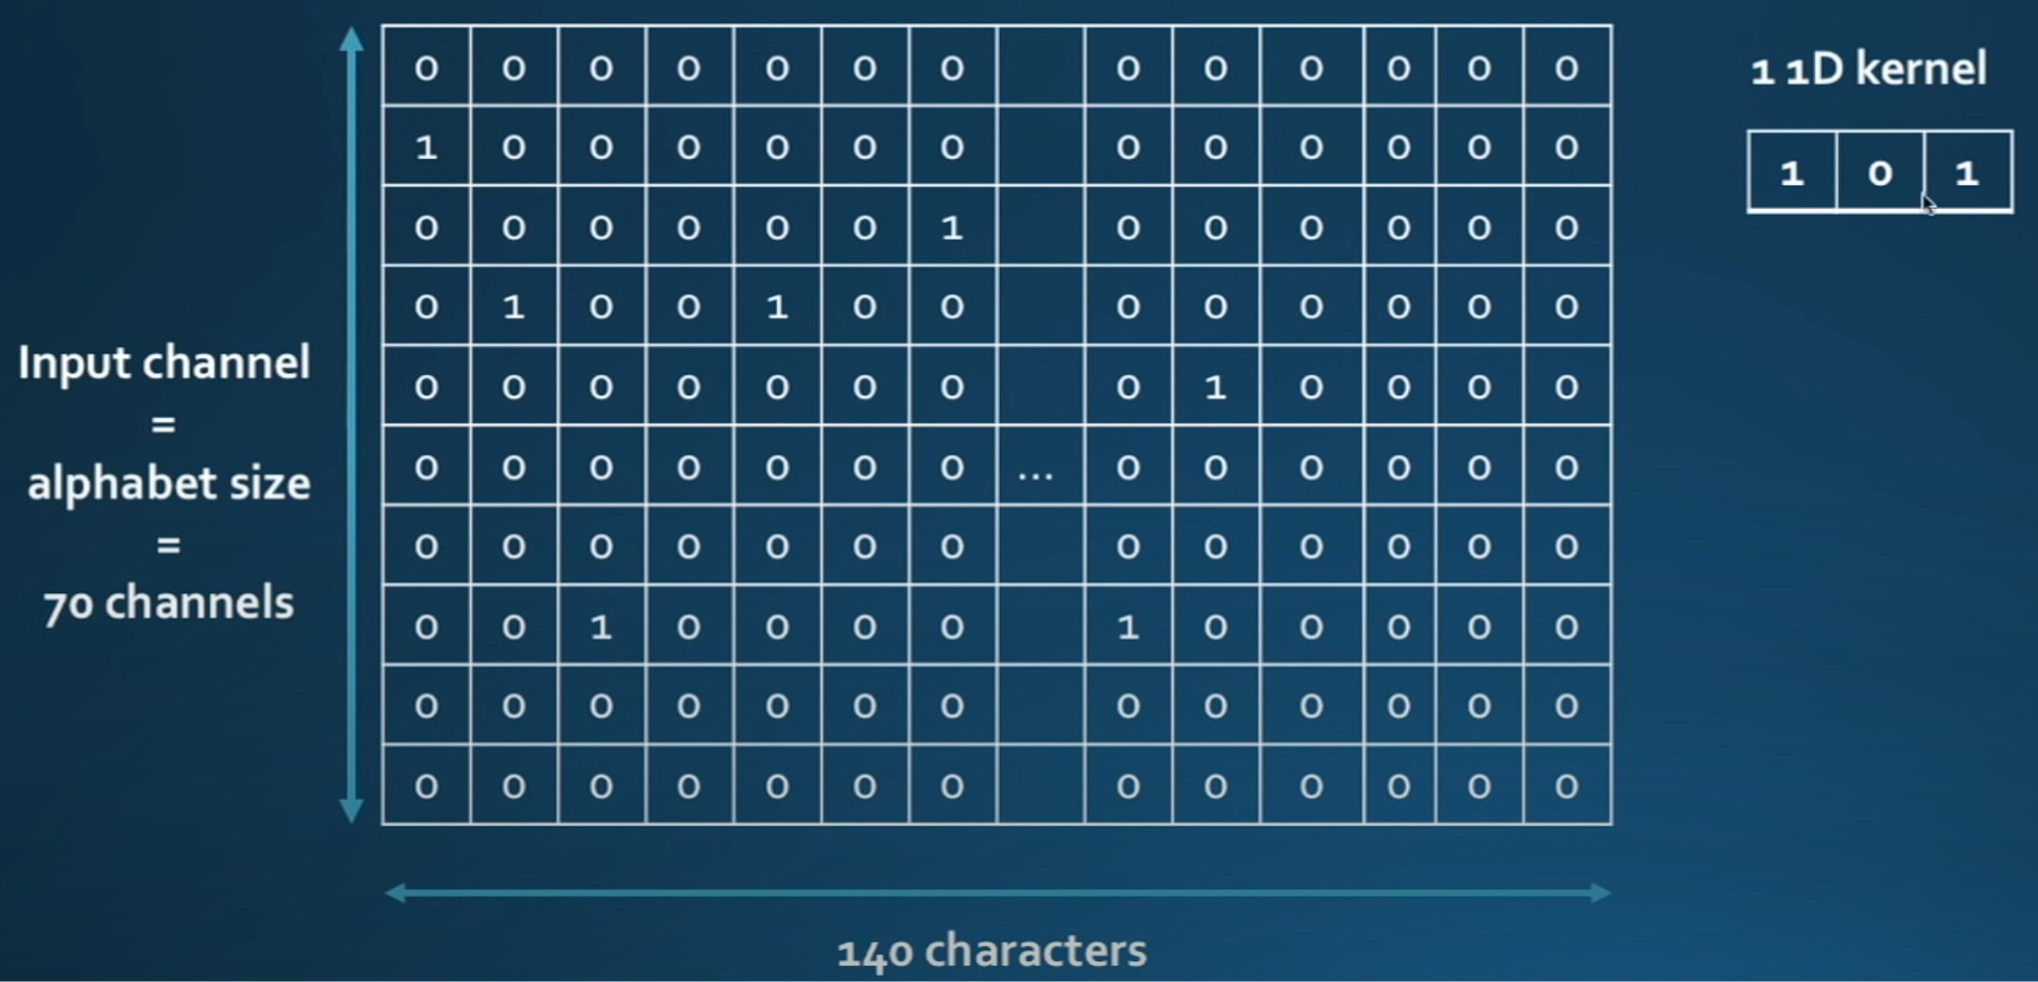
Machine Learning Method
4) CNN Model
- Each Column is the encoding of a word
(https://www.youtube.com/watch?v=CNY8VjJt-iQ&ab_channel=AhmedBesbes)

Slide 31
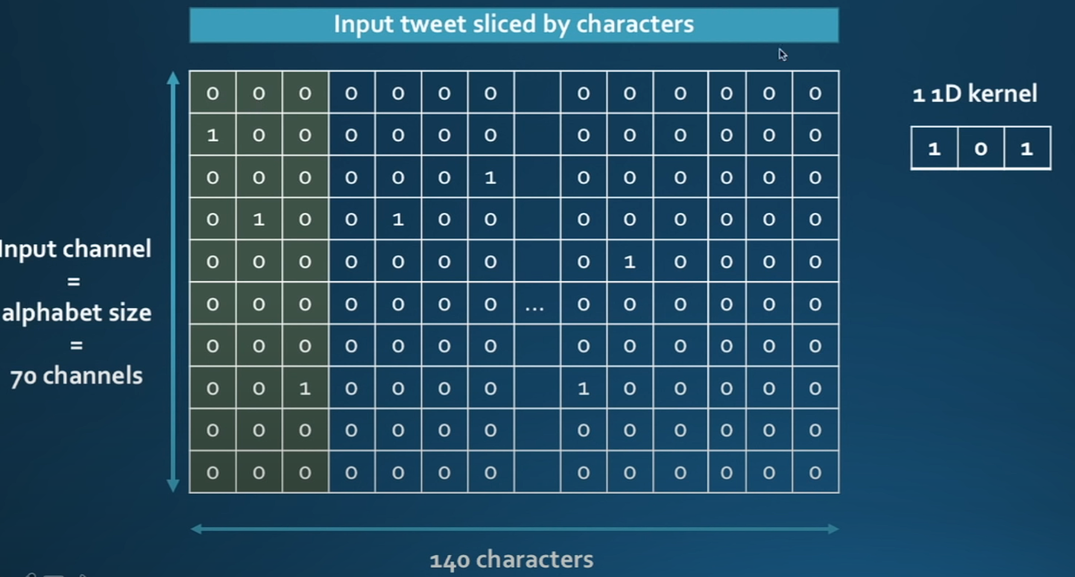
Machine Learning Method
4) CNN Model

Slide 32
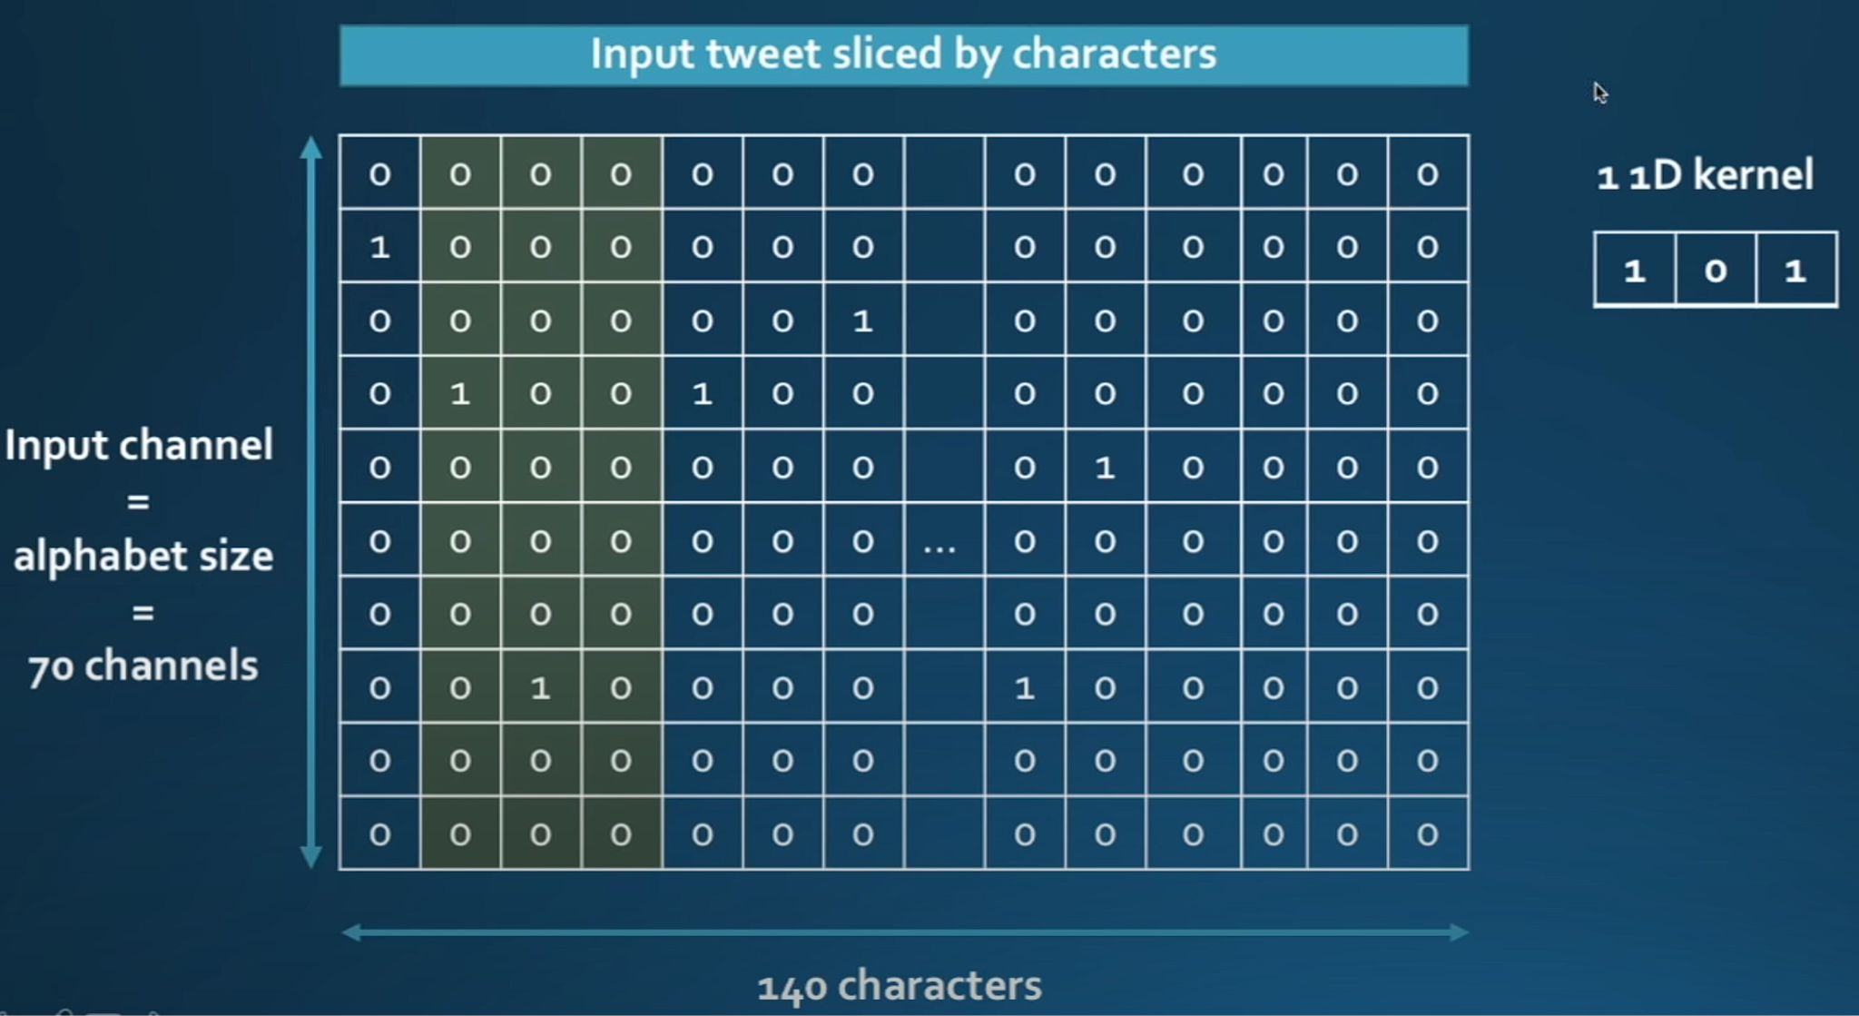
Machine Learning Method
4) CNN Model

Slide 33
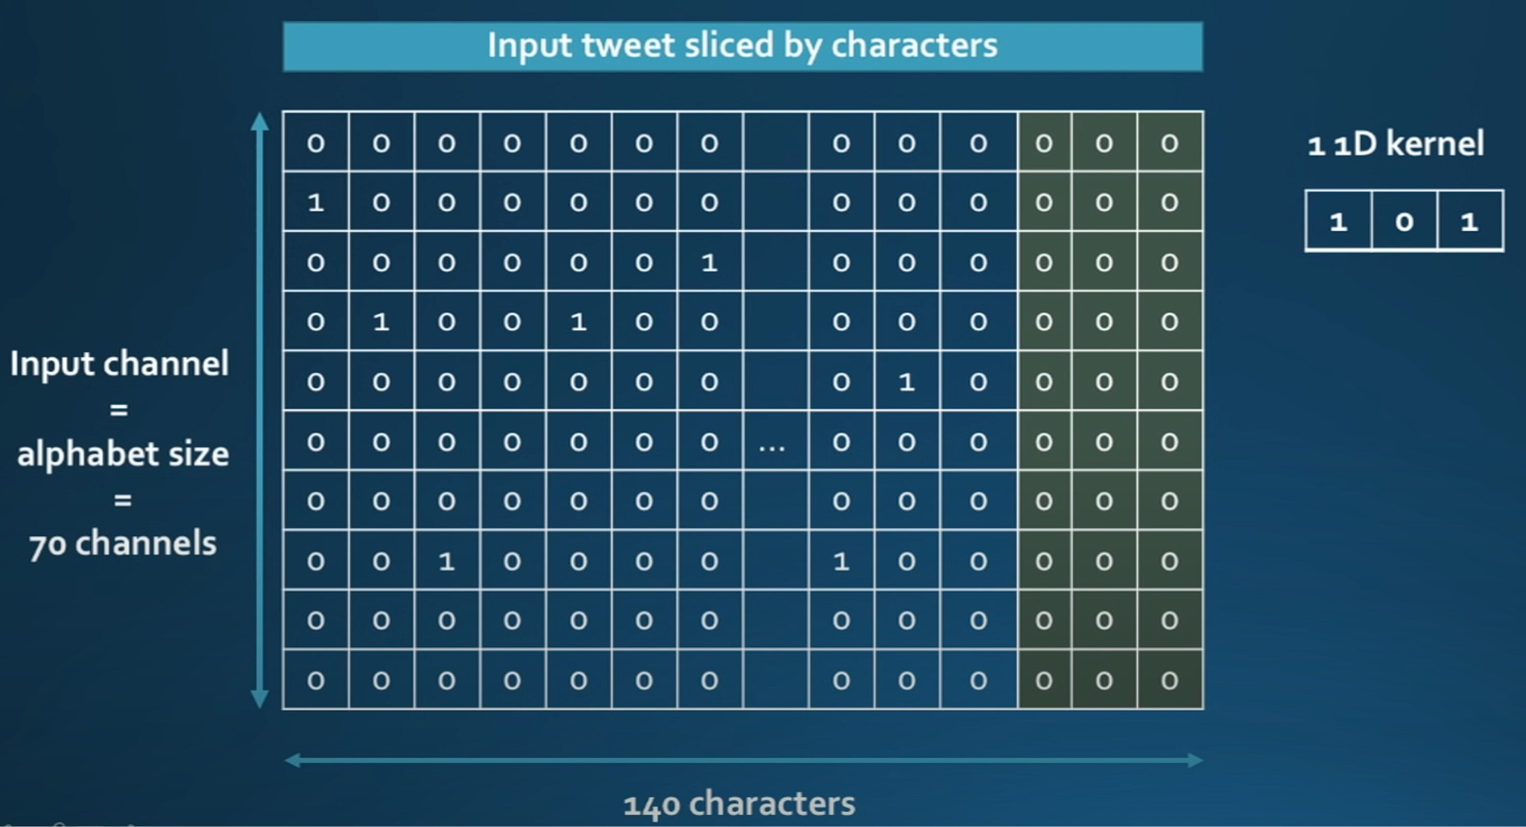
Machine Learning Method
4) CNN Model
Batch: 1 image
Input Channel: 70
Output Channel: 1
Output Shape: (1,1,138)

Slide 34
Machine Learning Method
5) DistilBERT Model
- “Distil” stands for distillation which means this model is a simple version of the original BERT model
- After that then perform the downstream task
Architecture \ Model | DistilBERT | BERT
Embedding vector for word | Yes | Yes
Positional Encoding | Yes | Yes
# of Encoder (Base) | 6 | 12
Encoder details | Self-attention + add & normalize + FFNN | Self-attention + add & normalize + FFNN

Slide 35
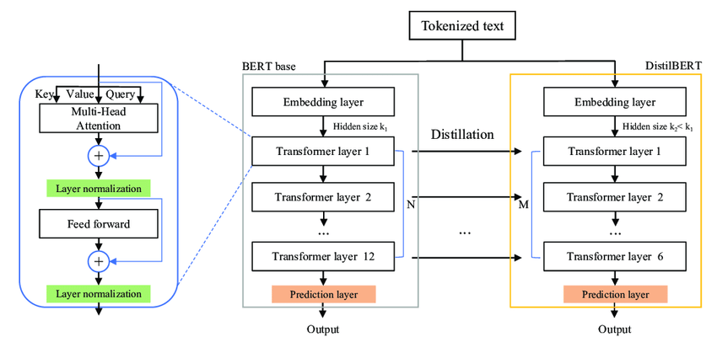
Machine Learning Method
5) DistilBERT Model
Initialization:
The first encoder’s weight of the DistilBERT Model will pick either layer 1 or 2 weights from the BERT model
The second encoder’s weight of the DistilBERT Model will pick either layer 3 or 4 weights from the BERT model
.
.
.
Until the last encoder

Slide 36
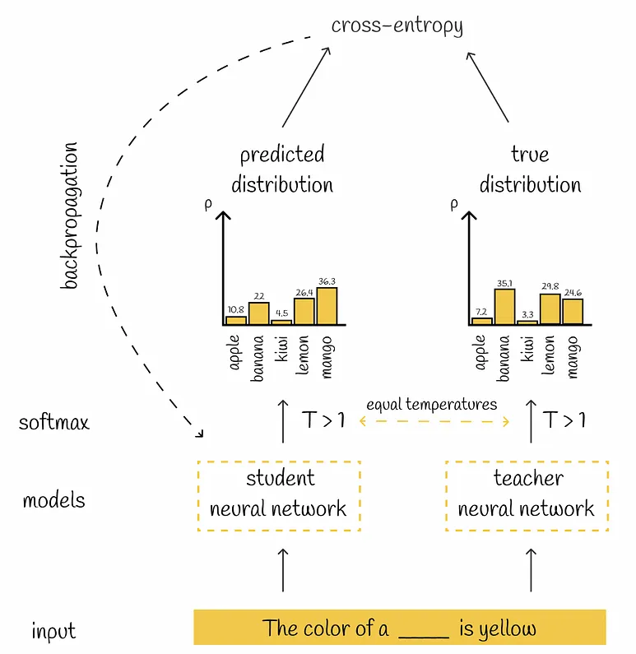
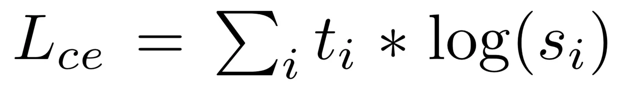
Machine Learning Method
5) DistilBERT Model
There are 3 loss function:
1) Distillation loss (cross-entropy loss)
where ti is the predicted output from BERT and si is the
predicted output from DistilBERT
The function of this loss is to help the DistilBERT model
learn from the BERT model, which is the student and
teacher relationship.

Slide 37
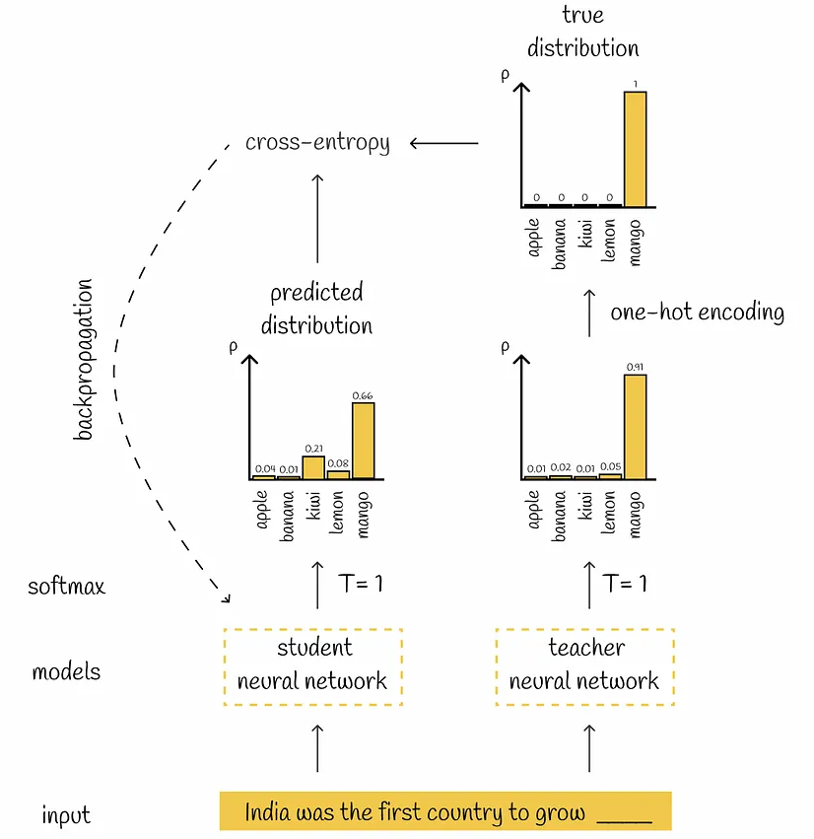
Machine Learning Method
5) DistilBERT Model
There are 3 loss function:
2) Masked Language Modeling (the same one as BERT)
- Also is a cross entropy loss
- Randomly masking 15% of the input and
predicting the masked words
- Learn the bidirectional representation of the sentence

Slide 38
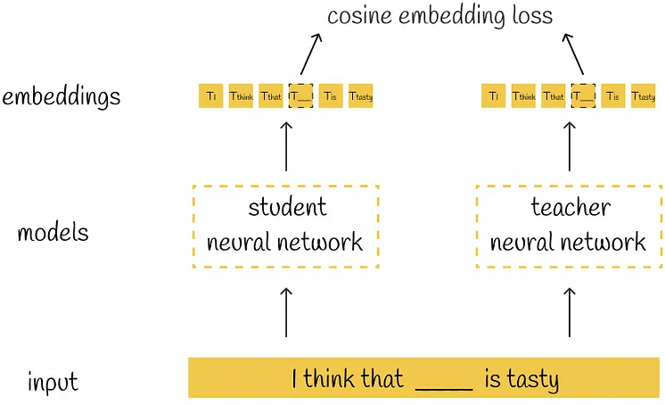
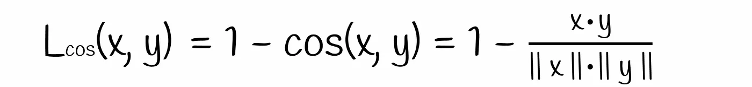
Machine Learning Method
5) DistilBERT Model
There are 3 loss function:
1) Cosine Embedding Loss
- The x and y are the predicted output after the BERT model’s
encoders and the DistilBERT model’s encoders respectively.
- Help the DistilBERT model construct the embedding and
mimic the behaviour of the BERT model as closely as possible

Slide 39
Machine Learning Method
6) XLNet Model
Propose by Google in 2019
During Model Pretraining:
Utilizes best things from (a) Autoencoding (AE) & (b) Autoregressive (AR) Language Modeling
Avoid the weaknesses of both Autoencoding & Autoregressive Language Modeling
Adopted 4 New Techniques to Boost the Performance:
(i) Permutation Language Modeling
(ii) Two-stream Self-attention
(iii) Relative Positional Encoding Scheme (from Transformer-XL)
(iv) Segment Recurrence Mechanism (from Transformer-XL)

Slide 40
Machine Learning Method
6) XLNet Model
Autoencoding (AE)
Pros: Perform Denoising
First model to use AE: BERT
Predict the randomly masked token using the bidirectional context

Slide 41
Machine Learning Method
6) XLNet Model
Autoencoding (AE)
Cons: Independence Assumption
All masked tokens are separately predicted
Joining conditional probability is assumed to be independent to each other
(Solved by Autoregressive (AR) Language Modeling due to lack of this assumption)

Slide 42
Machine Learning Method
6) XLNet Model
Autoencoding (AE)
Cons: Input Noise Problem
BERT contains [MASK]
Never appears in finetuning task
Result in pretrain-finetune discrepancy
(Solved by Autoregressive (AR) Language Modeling due to lack of dependence on any masked input words)

Slide 43
Machine Learning Method
6) XLNet Model
(b) Autoregressive (AR) Language Modeling
Pros: Maximise the Likelihood using the Forward Autoregressive Factorization
Example: Word Sequence [x₁, x₂, …, x_{t}]
Uses [x₁] to predict x₂
Uses [x₁, x₂] to predict x₃
Uses [x₁, x₂, …, x_{t-1}] to predict x_{t}

Slide 44
Machine Learning Method
6) XLNet Model
(b) Autoregressive (AR) Language Modeling
Cons: Only uses the context on the Left Side of the Token for Prediction
Cannot uses the context on the right side of the token for prediction
(Solved by Autoencoding (AE) due to the bidirectional context dependency)

Slide 45
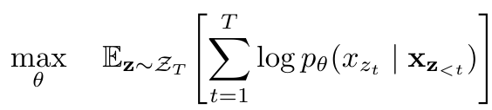
Machine Learning Method
6) XLNet Model
(i) Permutation Language Modeling
Aim: Collect bidirectional context information
Prevent: independence assumption & pretrain-finetune discrepancy problems
Borrowed from orderless NADE
Key idea: Permutation
Sequence x with length of T
T! Different orderings to perform autoregressive factorization
Bidirectional context capturing is possible

Slide 46
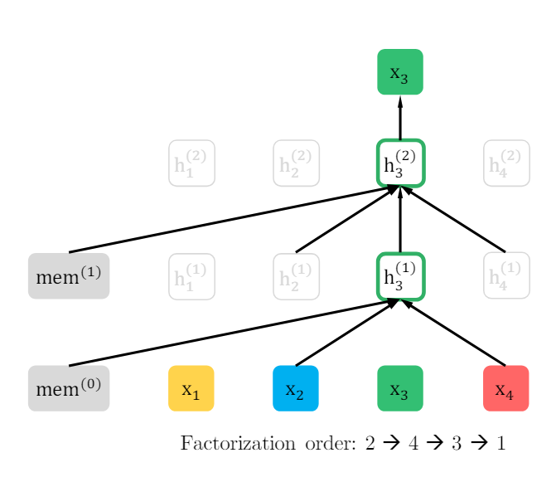
Machine Learning Method
6) XLNet Model
(i) Permutation Language Modeling
How to capture the bidirectional context without any masked tokens?
Given: a text sequence x
sample a factorization order z at one time
decompose the likelihood p_{θ}(x) according to factorization orders
x_{t} would see every possible element x_{i} ≠ x_{t} in the sequence

Slide 47
Machine Learning Method
6) XLNet Model
(i) Permutation Language Modeling
How to capture the bidirectional context without any masked tokens?
Initial sequence: [x₁, x₂, x₃, x₄]
New sequence after one round of permutation: [x₂, x₄, x₃, x₁]
Prediction target: x₃
Can attend to the context on the left x₂
Can attend to the context on the right x₄
x₃ can attend to [x₂, x₄, x₃]
2 points to note:
mem⁽⁰⁾ is the architecture of Transformer-XL
Permutation would not change the actual attention matrix

Slide 48
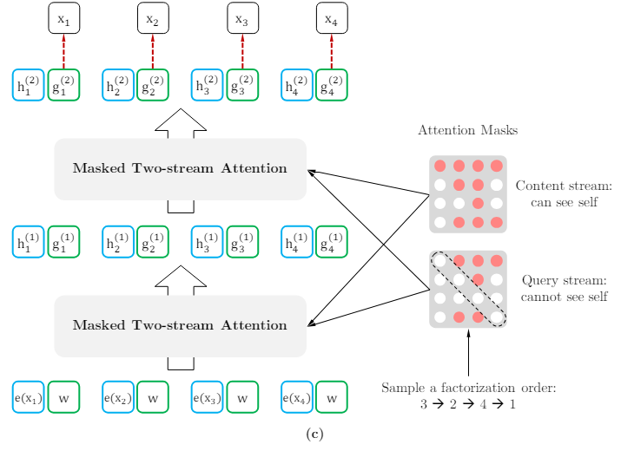
Machine Learning Method
6) XLNet Model
(ii) Two-stream Self-attention
Aim: Predict the location of a word token & bidirectional context relationship
2 streams:
Content stream
Query stream

Slide 49
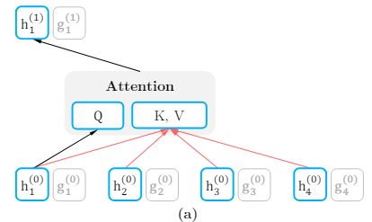
Machine Learning Method
6) XLNet Model
(ii) Two-stream Self-attention
Content stream:
Aim: learn the bidirectional context
Same as the standard self-attention
Content representation h: similar to a standard hidden state
(including context and the context information)
Example:
h₁ is Q
h₁ to h₄ as both K and V
h₁ would perform attention with x₁ to x₄ & gives attention weight
multiply with V to get the representation of h₁ in the second layer

Slide 50
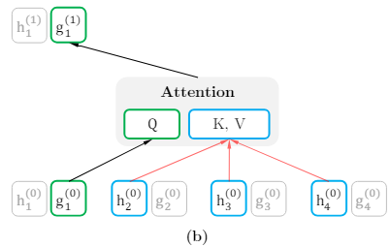
Machine Learning Method
6) XLNet Model
(ii) Two-stream Self-attention
Query stream:
Aim: Replace the [MASK] token in BERT
Query representation g: contains context information and position
(not including content)
Example:
g₁ is Q
h₂ to h₄ is K and V
Apply the equation below
g₁ attend to h₂ to h₄

Slide 51
Machine Learning Method
6) XLNet Model
(iii) Relative Positional Encoding Scheme (from Transformer-XL)
Aim: Tackle the weakness of absolute positional encoding
Consider relationship between a word position relative to another word position
Randomly initializing the word embeddings in each position
Create the pair-wise embedding matrix of size [T, 2*T - 1]
Row index: the word we concerned about
Column index: the relative positional distance from the word we are concerned about to other words
(including both before and after the concerned word)

Slide 52
Machine Learning Method
6) XLNet Model
(iii) Relative Positional Encoding Scheme (from Transformer-XL)
Example:
Simple sentence: “I like cats and dogs”
Get 2-dimensional vector encoding for each word after encoding:
I | [0.3, 0.7]
like | [0.2, 0.9]
cats | [0.4, 0.5]
and | [0.1, 0.3]
dogs | [0.8, 0.4]

Slide 53
Machine Learning Method
6) XLNet Model
(iii) Relative Positional Encoding Scheme (from Transformer-XL)
2D relative positional distance:
Closer relationship: “like” and “cats”, “like” and “dogs”
distance vector is smaller than other pairwise vector distances
Relative position of “like” relative to “I” | [0.1, 0.2] | Relative position of “and” relative to “like” | [0.3, 0.2]
Relative position of “cats” relative to “I” | [0.2, 0.4] | Relative position of “dogs” relative to “like” | [0.1, 0.1]
Relative position of “and” relative to “I” | [0.3, 0.7] | Relative position of “and” relative to “cats” | [0.3, 0.4]
Relative position of “dogs” relative to “I” | [0.4, 0.9] | Relative position of “dogs” relative to “cats” | [0.3, 0.6]
Relative position of “cats” relative to “like” | [0.1, 0.1] | Relative position of “dogs” relative to “and” | [0.3, 0.5]

Slide 54
Machine Learning Method
6) XLNet Model
(iv) Segment Recurrence Mechanism (from Transformer-XL)
Aim: each sentence segment from the past can be used with a new sentence segment
Avoid the same fixed-length context fragmentation embodiment
Equation for updating the attention with memory for the next segment x:

Slide 55
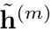
Machine Learning Method
6) XLNet Model
(iv) Segment Recurrence Mechanism (from Transformer-XL)
Example:
Two segments extracted from a long sequence s
: permutation of [1 … T]
z: permutation of [T + 1 … 2T]
Process the first segment
Cache the obtained content representations for each layer m
Update the attention with memory for the next segment x using the equation below:

Slide 56
Machine Learning Method
6) XLNet Model
(iv) Segment Recurrence Mechanism (from Transformer-XL)
Positional encodings depends on actual positions in original sequence of words only
Attention updating equation is independent of after the representation of is obtained
Cache & reuse the memory (without knowing the permutation order of the previous segment)
Expected: model can use the memory over all permutation orders of the last segment of sequence
Expected: query stream can be computed identically.

Slide 57
Experiment and Result

Slide 58
Experiment and Result
1) Naive Bayes Classifier
- According to the research “Heart disease prediction using Naive Bayes algorithm and Laplace Smoothing
technique” draws the conclusion that if a number of testing data do not appear in the training, after applying the
Laplace Correction will have a significant increase in the accuracy.
Hypothesis: We can use the Naive Bayes’ accuracy to estimate is the testing data is similar to training data
Independent variable: the Laplace Correction value (ie. alpha = 0 means don’t perform and alpha = 1 means adding 1 count to each word to obtain no zero probability which is Laplace Correction)
Dependent Variable: The accuracy of both Naive Bayes classifier which has or hasn’t Laplace Correction.
Fixed Condition: The training data and testing splitting in both cases are the same and CountVectorizer() performs the counting of each word for preparing the probability in the Naive Bayes Classifier.
Process: We utilize MultinomialNB() with one set alpha to 0 and another one set alpha to 1 to perform the testing. Then we fit the same training data into both of them and use two models to predict on same testing data.

Slide 59
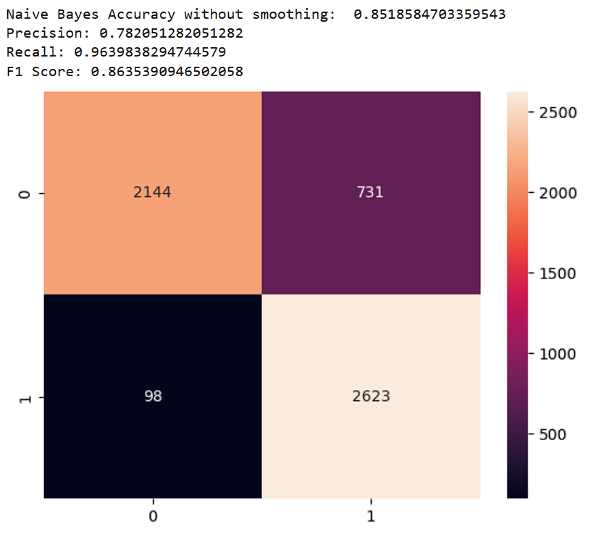
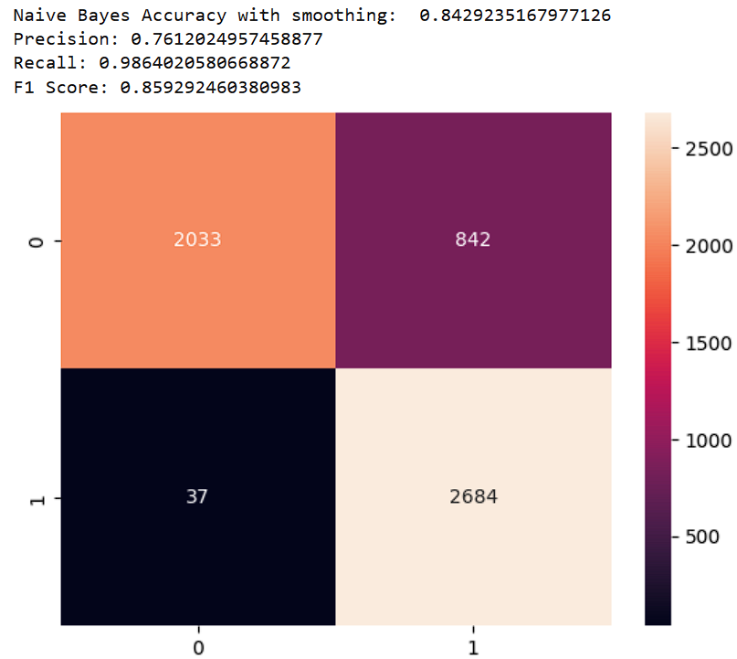
Experiment and Result
1) Naive Bayes Classifier
Alpha = 0: Alpha = 1:

Slide 60
Experiment and Result
1) Naive Bayes Classifier
- Accuracy without Laplace Correction is 0.8518584703359543
- Accuracy with Laplace Correction is 0.8429235167977126
- Time usage for both trials is 1.5413191318511963 seconds
From the data distribution part:
The probability of the most frequent word appearing in the testing data which is also in the most frequent of the
training data is 39/40 = 97.5%
** Utilizing the Naive Bayes with or without Laplace Correction, if the accuracy is similar which implies the data in
both training and testing is also similar, if the accuracy has a significant improvement after applying Laplace
Correction which implies there are more variations in the training and testing data.

Slide 61
Experiment and Result
2) One-Hot Model by MLP
Prior knowledge: Shorter length of the one-hot encoding will reduce the information and the dimensionality which may lower the accuracy
but have a less usage of the RAM.
Question: How the model will be affected or limited by a shorter encoding.
Independent Variable: Length of the encoding or model architecture
Dependent Variable: The accuracy, precision, recall and F1 score for the three models
Process: In the first trial, we fixed the length of the one-hot encoding to be 100. Then we have one less complex MLP and one more
complex MLP model for training and comparison. Afterwards, we fixed the MLP model to be the one with less complexity and performed
the comparison with one using an encoding length is 100 and another one with an encoding length is 1000.

Slide 62
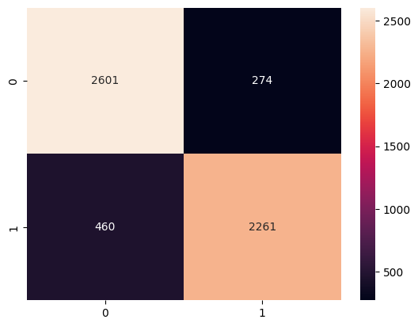
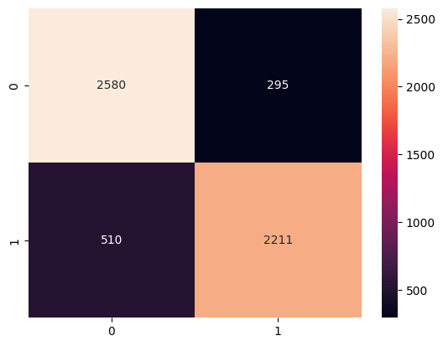
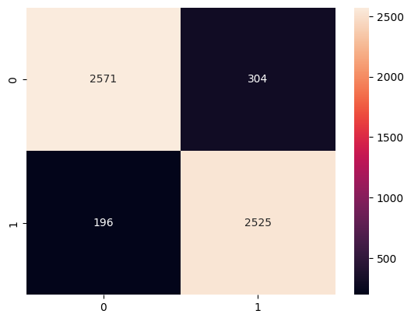
Experiment and Result
2) One-Hot Model by MLP
Length 100 with simple model performance: Length 100 with complex model performance: Length 1000 with simple model performance:
accuracy = 86.88%, the precision = 89.19%, accuracy = 85.61%, the precision = 88.23%, accuracy = 91.07%, the precision = 89.25%,
the recall = 83.09%, the F1 score = 86.04% the recall = 81.26%, the F1 score = 84.60% the recall = 92.80%, the F1 score = 90.99%

Slide 63
Experiment and Result
2) One-Hot Model by MLP
Length 100 with simple model performance: Length 100 with complex model performance: Length 1000 with simple model performance:
accuracy = 86.88%, the precision = 89.19%, accuracy = 85.61%, the precision = 88.23%, accuracy = 91.07%, the precision = 89.25%,
the recall = 83.09%, the F1 score = 86.04% the recall = 81.26%, the F1 score = 84.60% the recall = 92.80%, the F1 score = 90.99%
We can see that even though we increase the capability of the model, we still cannot improve any metrics.
We can see that 3 metrics out of 4 have a great improvement even though we are using the less complex model.
Conclusion: The length of the encoding is a critical factor in determining the performance of the MLP model.

Slide 64
Experiment and Result
3) Model Comparison and Best Model for Mental Health Classification
Question: There are so many models we have implemented. Which model works best for the task?
Independent Variable: 6 different models
Dependent Variable: The computational power (time and memory usage), model performance (accuracy, precision,
recall and F1 score)
Process: We built all models as the last part stated with their performance. So we can directly jump to the result part.

Slide 65
Experiment and Result
3) Model Comparison and Best Model for Mental Health Classification
Naive Bayes Classifier:
a) Advantages
Fast, only takes 1.5413191318511963 seconds for both tasks
b) Disadvantages:
Assumption: Equal contribution and independent probability (not the case in real world)
c) Performance (with Laplace Correction)
The accuracy 84.29%, precision 76.12%, recall 98.64%, F1 score 85.93%
One-Hot MLP model
a) Advantages
Fast, 1 to 2 seconds for each epoch
b) Disadvantages:
Dense Layer treated every input as independent
One-hot encoding requires lots of RAM usage
c) Performance (Encoding Length = 100 with simple model)
The accuracy = 86.88%, the precision = 89.19%, the recall = 83.09%, the F1 score = 86.04%

Slide 66
Experiment and Result
3) Model Comparison and Best Model for Mental Health Classification
Index RNN model:
a) Advantages
It has embedding layer, each word can have better representation
LSTM layer can have a better semantic understanding
LSTM gate mechanism can prevent the vanishing gradient problem
b) Disadvantages:
Training time is longer, 27 - 32 seconds for each epoch
LSTM is like a “black box” and it is hard to understand the interpretation in it.
c) Performance (with Laplace Correction)
The accuracy = 88.46%, the precision = 90.04%, the recall = 85.74%, the F1 score = 87.84%

Slide 67
Experiment and Result
3) Model Comparison and Best Model for Mental Health Classification
CNN Model:
a) Advantages
It has embedding layer, each word can have better representation
Convolution layer can easily capture the pattern of the sentences
Training time is relatively faster, 10 seconds per each epoch
b) Disadvantages:
Cannot perform well in adversarial attacks and not general enough (only learn the pattern but not semantic
meaning)
c) Performance (with Laplace Correction)
The accuracy = 91.53%, the precision = 92.87%, the recall = 89.45%, the F1 score = 91.13%

Slide 68
Experiment and Result
3) Model Comparison and Best Model for Mental Health Classification
DistilBERT:
a) Advantages
Contextual understanding -> self-attention mechanism
Bidirectional understanding -> Mask mechanism
Have pre-trained model
b) Disadvantages:
Training time is long, 4 minutes for each epoch
c) Performance (with Laplace Correction)
The accuracy = 92.12%, the precision = 91.16%, the recall = 92.80%, the F1 score = 91.97%

Slide 69
Experiment and Result
3) Model Comparison and Best Model for Mental Health Classification
XLNet Model:
a) Advantages
- Both autoencoding (AE) and autoregressive (AR) benefits -> permutation language modeling
- Better positional information -> relative positional encoding
- Two-stream self-attention mechanism (can hide the content of current position in Query) is better than
self-attention mechanism in BERT
- Pre-trained model
b) Disadvantages:
Training time is long, 10 minutes for each epoch
c) Performance (with Laplace Correction)
The accuracy = 93.07%, the precision = 88.43%, the recall = 98.64%, the F1 score = 93.26%

Slide 70
Experiment and Result
3) Model Comparison and Best Model for Mental Health Classification
Which is the best model for mental health classification?
- Human language is ambiguous, so we should choose the model that can understanding the semantic meaning
❌Naive Bayes, One-Hot MLP, CNN model
- Accuracy for the three models is similar but the recall metric of the data is much more important than the others
High recall means that there are less people who have mental health problems but are classified as having no
problems
We want to catch as much as possible if the people is having problems in the purpose
SO, Recall of XLNet is 98.64%, distilBERT is 92.80% and the Index RNN model is 85.74%.
- XLNet is the best model that we examine to solve this mental health classification problem.

Slide 71
Thanks!

Slide 72
Material that accessed
Cherian, V., & Bindu, M. S. (2017). Heart disease prediction using Naive Bayes algorithm
and Laplace Smoothing technique. Int. J. Comput. Sci. Trends Technol, 5(2), 68-73.
Dai, Z., Yang, Z., Yang, Y., Carbonell, J., Le, Q. V., Salakhutdinov, R. (2019).
Transformer-XL: Attentive Language Models Beyond a Fixed-Length Context. arXiv:1901.02860
Efimov, V. (2023, October 9). Large language models: DistilBERT — smaller, faster, cheaper and lighter. Medium. https://towardsdatascience.com/distilbert-11c8810d29fc
Kianyew, N. (2024, January 7). What is Relative Positional Encoding. Medium.
https://medium.com/@ngiengkianyew/what-is-relative-positional-encoding-7e2fbaa3b510
Pei, C. T. (2021, December 13). DistilBERT — 更小更快的BERT模型 - NLP-Trend-and-Review - Medium. Medium. https://medium.com/nlp-tsupei/distilbert-%E6%9B%B4%E5%B0%8F%E6%9B%B4%E5%BF%AB%E7%9A%84bert%E6%A8%A1%E5%9E%8B-eec345d17230
Sanh, V., Debut, L., Chaumond, J., & Wolf, T. (2019). DistilBERT, a distilled version of
BERT: smaller, faster, cheaper and lighter. arXiv preprint arXiv:1910.01108.
Tsoi, Y. C., Xiao, H. R., Naive Bayes Classifier.
https://course.cse.ust.hk/comp2211/notes/3-naive-bayes-full.pdf

Slide 73
Material that accessed
Xiao, M. (2020, May 5). Understanding Language using XLNet with autoregressive
pre-training. Medium. https://medium.com/@zxiao2015/understanding-language-using-xlnet-with-autoregressive-pre-training-9c86e5bea443
Yang, Z., Dai, Z., Yang, Y., Carbonell, J., Salakhutdinov, R. R., & Le, Q. V. (2019). XLNet:
Generalized Autoregressive Pretraining for Language Understanding. Advances in
neural information processing systems, 32.

